Slide 1
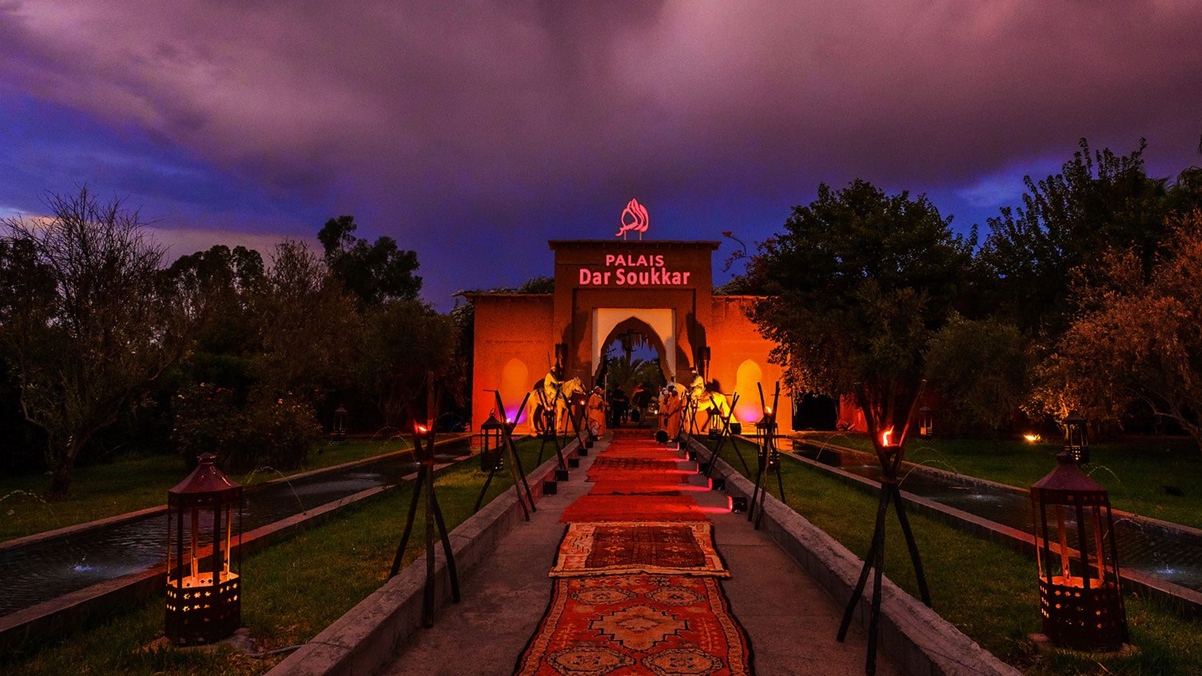

Slide 2
THE OLD
SUGAR FACTORY
Dar Soukkar in Arabic means The Sugar Factory. The property is set within 10 minutes' walk from Marrakech city center. This is a mythical place that was built in the sixteenth century, leaving some vestige even of that time. In 2004 it was completely renovated to be the scene of the greatest events held in Marrakech.
It is divided into several spaces, the first of them the main living room with capacity of 280 covered with an annex separated by doors with capacity for another 100 places. Once this large lounge has been transferred, the space called The Lounge also has another 140 cutlery. In total in the interior area has more than 500 cutlery. On the terrace has space decorated for dinners with more than 600 other covered seated and 1500 in cocktail dinner.
During dinner there are different shows between live singer, belly dancers, Gnaouas acrobats or African tribes.
Its cuisine has the purest Moroccan style with new flavors and presentations in addition to the most refined international cuisine.

Slide 3
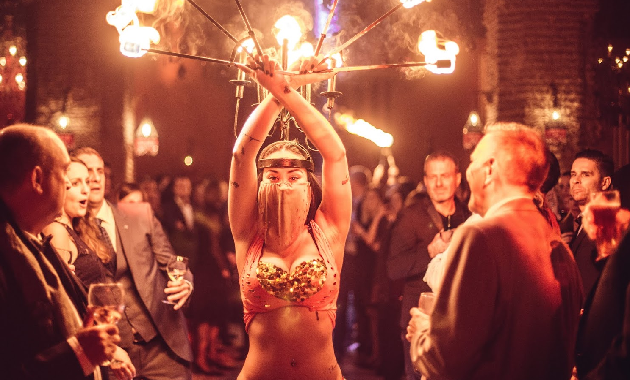

Slide 4
ARTISANS OF THE UNIVERSAL KITCHEN
INTERNATIONAL MENU Dish on brioche focaccia with tomato and olives Salmon fillet with pea puree, vegetable garden and saffron butter or low temperature chicken fillet in the manner of the crying Tiger. Amlou crisp with nuts and spiced chocolat.
MOROCCAN MENU Assortment of Moroccan salads Variety of Briouats (meat, cheese and vegetables) Lamb tagine with candied tomatoes, caramelized onions and raisins or beef with prune and apricot. Amlou crisp with nuts and spiced chocolate
After dinner, they will have a place to have drinks with an international orchestra and open bar and later, at different times, move to the hotel.

